Slide 1
Group 2 Level Designs
Elliot Page
Max Carter
Rebecca Brannum

Slide 2

Level 1 Style guide

Slide 3
Level 2 Style Guide

Slide 4

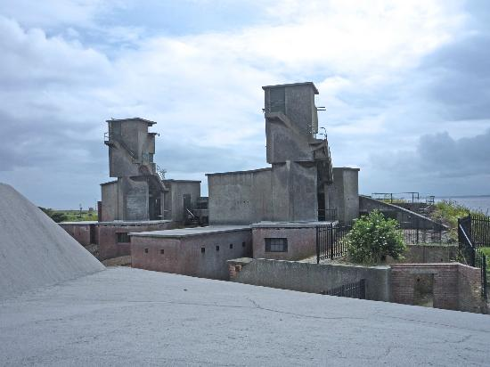
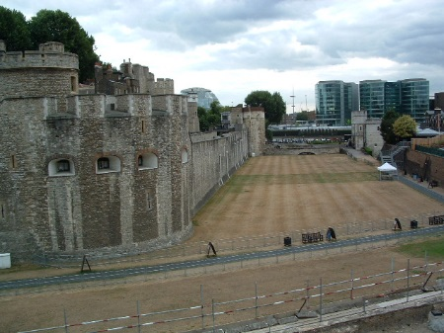
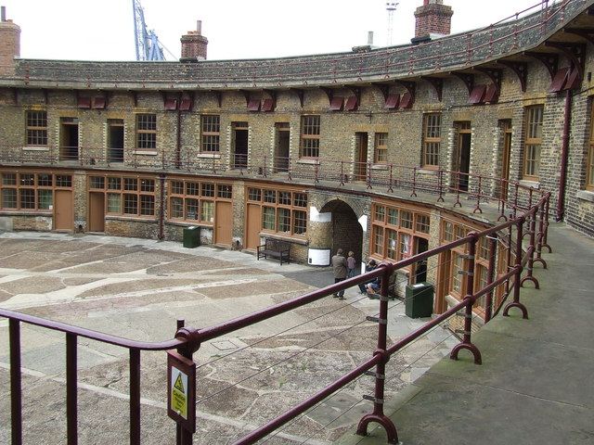
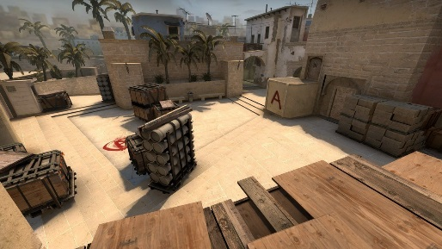
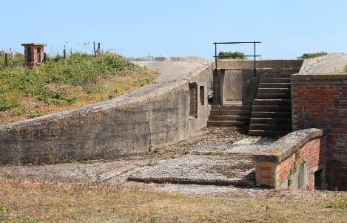
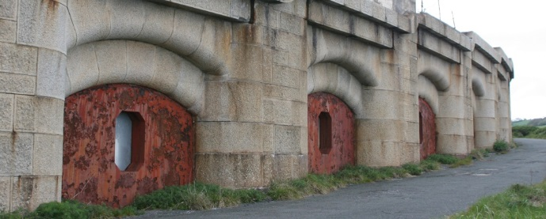
Level 3 Style Guide

Slide 5
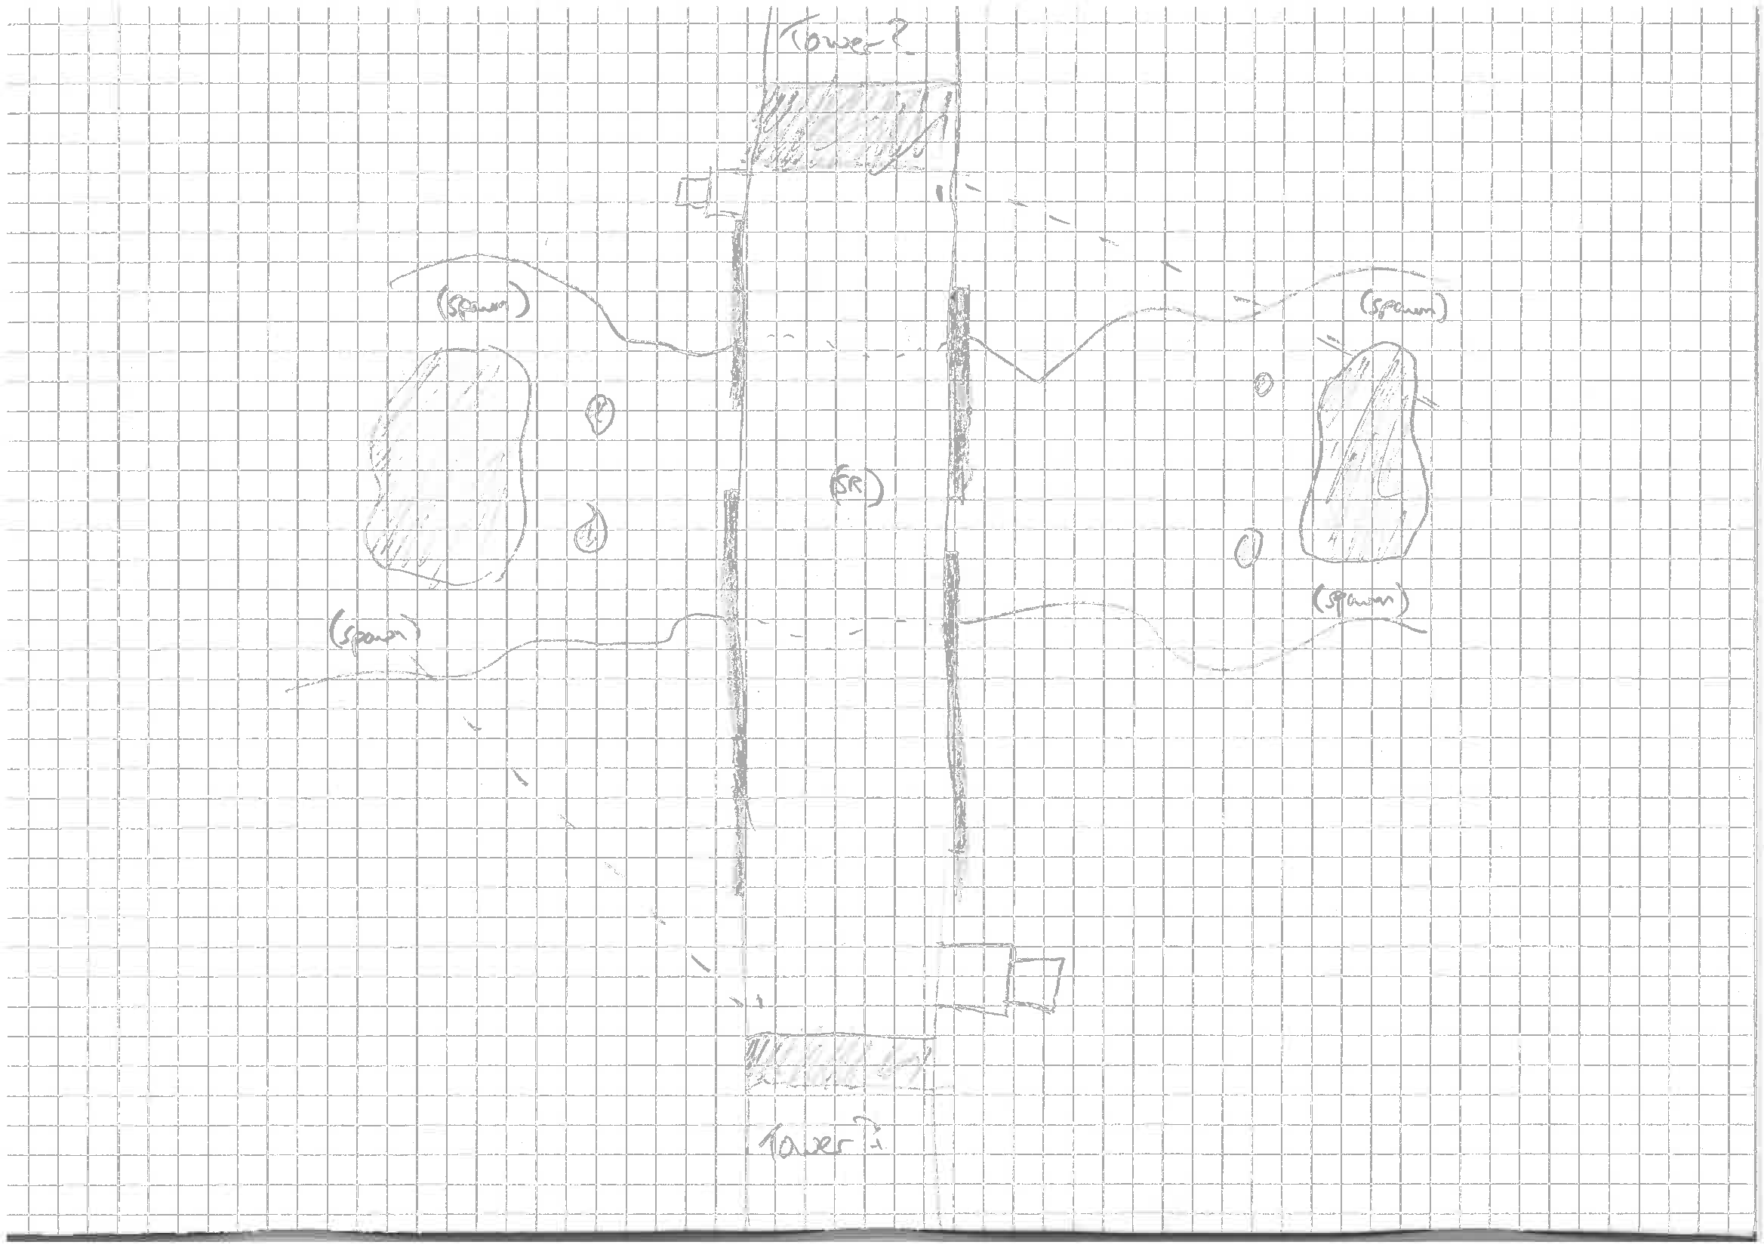
Level 1
Asset List
Metallic walls (grey)
Bridge chain
Boulders
Awnings/balconies
Weapons from UT4
Gravel texture
Zipline
Wasteland skybox

Slide 6
Level 2
Metal panels (silver)
Space skybox
Solid metallic flooring
Command console/computers
Pickups from UT4
Lifts
Air ducts
Floating platforms
Teleporters

Slide 7
Level 3
https://sketchfab.com/models/2cbda2361fc94f87a62b80f00b896d3d

Slide 8
Research and References
De Jong, S (2008). The Hows and Whys of Level Design. 2nd ed. Raleigh: Lulu. p26.

